Slide 1
Enrollment Dashboards at NECC
Presentation to the DHE Trustee Convening
October 27, 2021

Slide 2
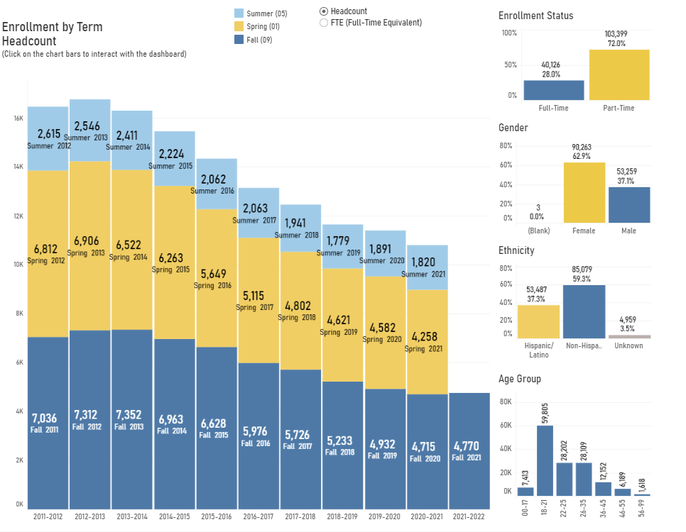
Facing NECC’s Enrollment Challenge Head-On
Value transparency
Provide clear communication
Share data widely and consistently
Promote Collaboration

Slide 3
Inception of Enrollment Dashboard Working Group
Representatives from key areas of the college
Academic Affairs
Student Affairs
Institutional Effectiveness
Admissions
Early College
Marketing
“Strategy Owners” for different student groups
Bi-weekly meetings about enrollment trends

Slide 4
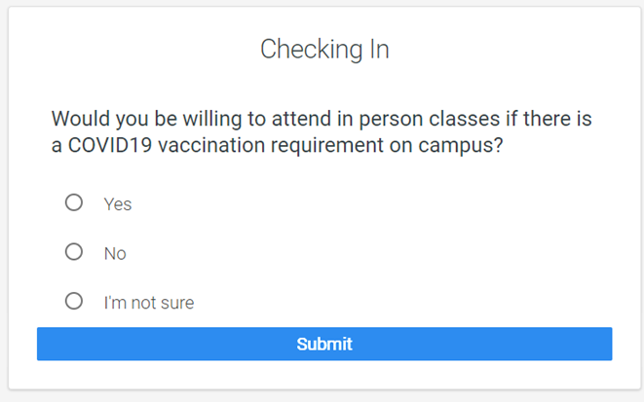
Asking Actionable Questions
Collecting new sources of data
Qualitative:
Navigate Platform – Quick Polls
Student Ambassador Outreach
Texting campaigns
Conducting informal focus groups
Acting on our findings:
Positive student response
Targeted outreach based on response
Admissions welcome videos created by students

Slide 5
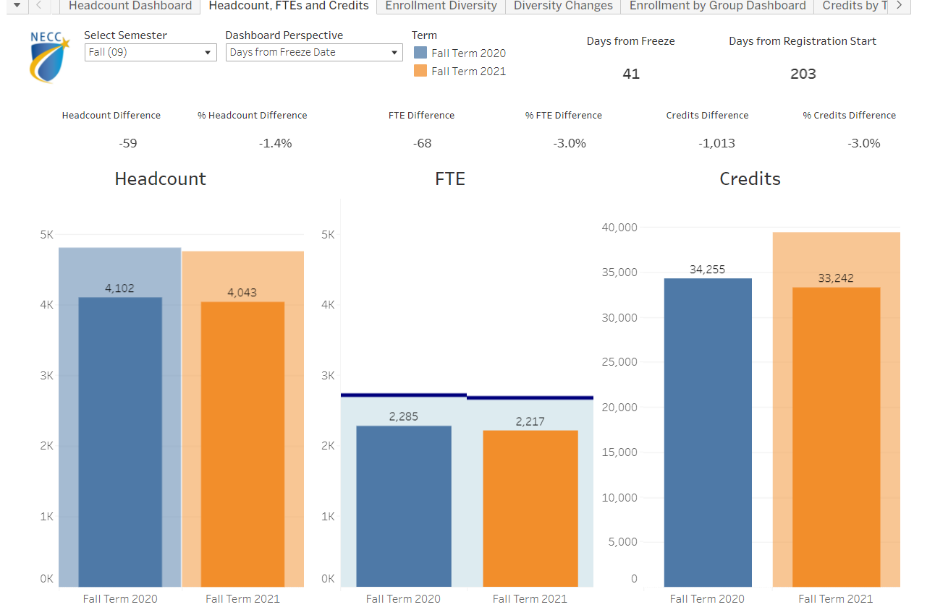
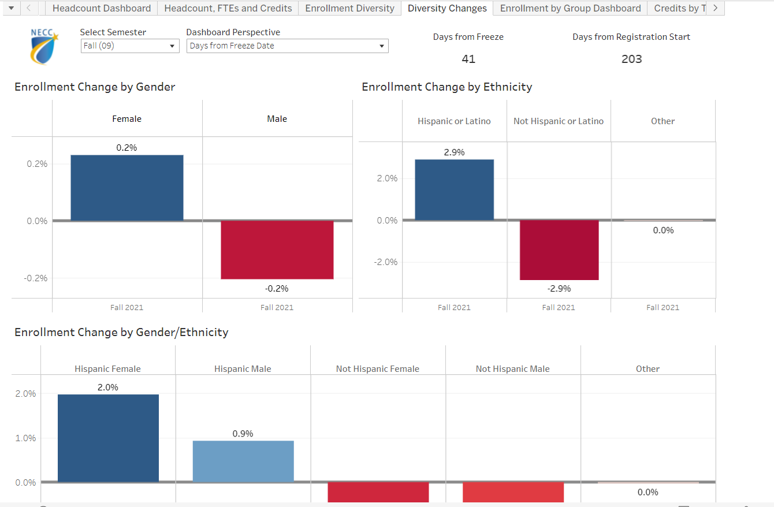
Making Daily Enrollment Trends Accessible
Created in partnership with AVAAP
Available to college-wide community on MyNECC Portal (not password protected)
Highlights daily trends, updated nightly
Disaggregated by race, ethnicity, gender, and more
Provides multiple “Perspectives”
Uses Hispanic vs. Non-Hispanic Lens as we are an HSI
Relied upon by Senior College leaders, Deans, Unit leaders, and individuals across campus

Slide 6
necc.mass.edu

